Slide 1

Collaborative whiteboard website
By Joshua bouvier
ce301

Slide 2
What is the purpose of the whiteboard?
It can be used to present information or collaboratively create information.
The whiteboard can be used as a learning tool for both personal, business and educational use or in any working or collaborative environment. This is because of its networking ability allowing it to be shared across multiple devices, meaning many people can work or view the whiteboard at once.
To allow people to express ideas and thoughts onto a blank canvas, or to potentially solve issues they are unable to do in their head.

Slide 3
How can it be helpful in an e-learning environment?
In the UK (especially England) due to a £15 billion pound push back in 2015 wall mounted whiteboards are extremely common in classrooms[1]. Study's have suggested that students prefer to use a whiteboard and that it makes the lesson more interesting and that its easier to concentrate[2].
Whilst both physical and interactive whiteboards are quite popular in schools, another popular set of tools in schools is the growing use of laptops and tablets. These could give an extra set of functionality to a wall mounted whiteboard, with the ability of students all being able to view and/or work on the whiteboard at once. It could also have extra added uses of it being much easier to present a students work to the class.
[1]S. DiGregorio P “The Effects of Interactive Whiteboards (IWBs) on Student Performance and Learning: A Literature Review.”, Journal of Educational Technology Systems, 2010. [Online]. Available: https://journals.sagepub.com/doi/pdf/10.2190/ET.38.3.b
[2] W. Beeland, "Student Engagement, Visual Learning and Technology: Can Interactive Whiteboards Help?", Vtext.valdosta.edu, 2002. [Online]. Available: https://vtext.valdosta.edu/xmlui/bitstream/handle/10428/1252/beeland_am.pdf?sequence=1&isAllowed=y.

Slide 4
What are the technical achievements so far?
Drawing to a canvas (only computer)
Networking drawing across devices; incl across computer and mobile
Networking the colour of what you draw; incl across computer and mobile
Networking clearing the whiteboard; incl across computer and mobile
Networking a basic implementation of joining and leaving whiteboard sessions, meaning multiple people can be viewing/working on multiple sets of whiteboards at once; viewing available on computer and mobile, editing only on computer

Slide 5
Why are the project objectives for the whiteboard?
A networked whiteboard which allows for an unlimited amount of people to spectate or edit a whiteboard
A saving system to store and load whiteboards
The ability to set permissions on whiteboards, for example letting a teacher or presenter have control over a whiteboard and students or spectators only being able to view them
The ability to do more than just draw to a whiteboard, but to add text, images & shapes etc
The ability to undo and redo changes to a whiteboard
The ability to rescale the whiteboard (both zooming in and out and side to side)
Full mobile support
A fully accessible UI (for including anyone with potential learning or visual difficulties)

Slide 6
What's the plan on implementation?
Currently, the core has been completed. That being the whiteboard and basic networking capability. What needs to happen next is improvement of the code & the adding of networked features.
This would be best done step-by-step adding one feature at a time, starting with loading/saving of boards (as this requires a choice of database), a full implementation of sessions between whiteboards, permissions for whiteboards, scaling and resizing, adding extra cosmetic features like shapes, text, images etc as I would like for them to work with scaling and resizing.
Finally I would move onto adding full mobile support and stylising the UI.
Any risks?
Not really – the biggest holdup will most likely be the resizing and scaling of the whiteboard. This will require a fair amount of maths and could be quite intensive on the client so this might be a feature that has to be abandoned

Slide 7
Demo

Slide 8
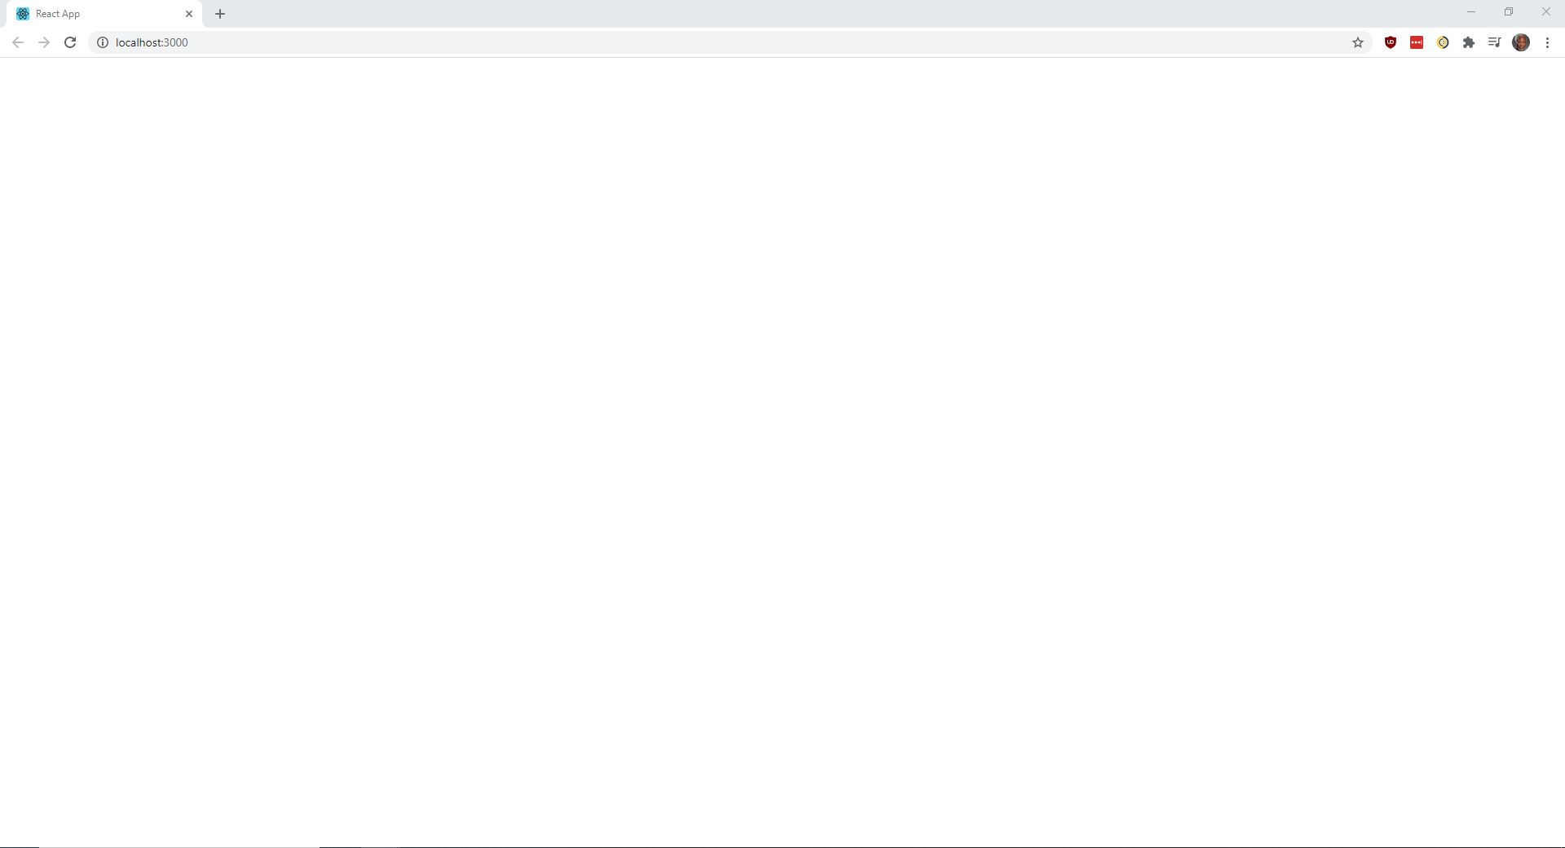
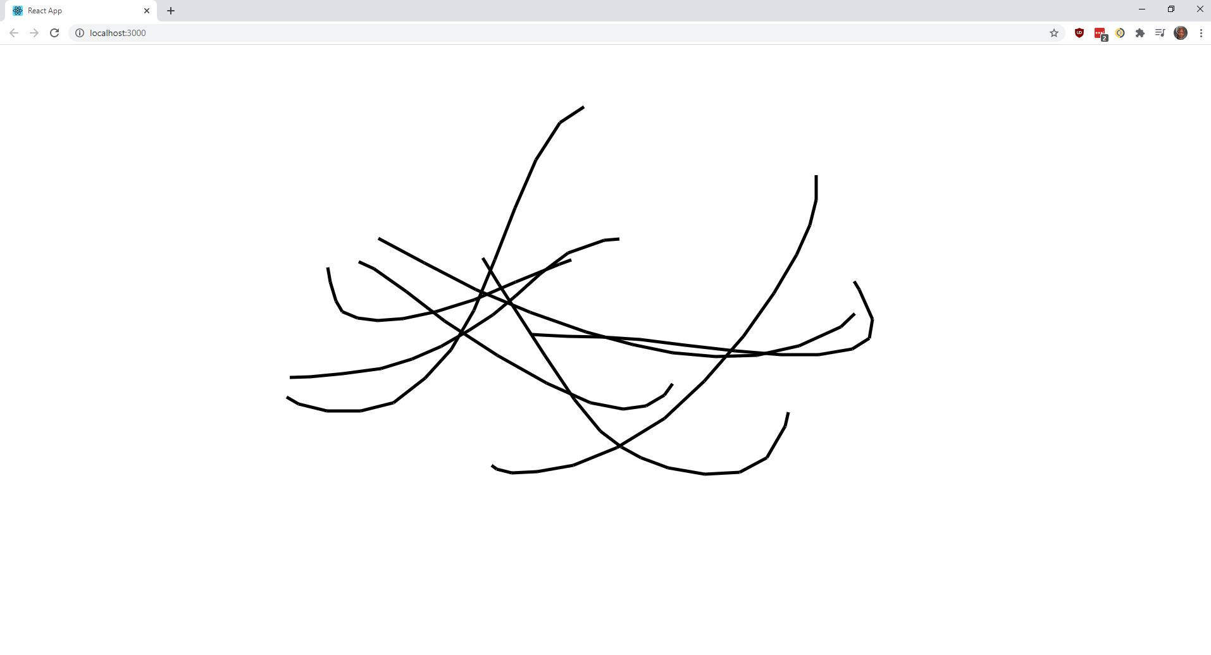
(for if demo failure)
A blank canvas
Drawing on the canvas

Slide 9
(for if demo failure)
Drawling a networked line
Whiteboard over multiple sessions

Slide 10
Any questions?

